Slide 1
Ques: Design a 3-bit sequence detector using D Flip-Flops to detect a sequence ‘101’. Don’t allow overlapping. Show the state diagram for Mealy and Moore Machine based implementation. Design the Mealy Machine based implementation.

Slide 2
Concepts
Objective:
Design a 3-bit sequence detector using D Flip-Flops that detects the bit pattern “101”.
No overlapping allowed → after detecting “101”, the machine must reset instead of reusing part of the sequence.
Show state diagrams for Mealy and Moore machines.
Finally, implement the Mealy machine with D Flip-Flops.

Slide 3
Step 1: Understanding the Problem
A sequence detector checks a serial bit stream (one bit per clock) and outputs 1 whenever a particular sequence is found.
Here, the sequence is 101.
“No overlapping” means if the input is 10101, only the first “101” is detected, and the machine resets before looking for another match.
👉 Example:
Input stream: …1010…
Output stream: …0010…
Detection at the end of “101” gives output 1.
Then it resets before continuing.
Step 2: Difference Between Mealy and Moore Machines
Mealy Machine: Output depends on state + input.
  Advantage: Fewer states, faster detection (output is immediate).
Moore Machine: Output depends on state only.
  Advantage: Simpler conceptual model, but more states needed.
👉 In our case, we will design both diagrams but implement the Mealy version.
Step 3: Define the States
We define states based on how much of “101” we have matched so far:
S0: Initial state (no bits matched yet).
S1: Detected first 1.
S2: Detected 10.
S3: Detected full sequence 101.
Because we don’t allow overlapping, after reaching S3 we must reset to S0.

Slide 4
State Transition Diagram
0/0
S0
Step 4: Mealy Machine Design
In a Mealy machine, the output is shown on transitions (state + input).
S0:
  Input 0 → stay in S0, output 0.
  Input 1 → go to S1, output 0.
S1 (matched first 1):
  Input 0 → go to S2, output 0.
  Input 1 → stay in S1, output 0.
S2 (matched 10):
  Input 1 → detected 101 → go to S3, output 1.
  Input 0 → reset to S0, output 0.
S3 (matched 101):
  Output 1 given already → reset to S0 regardless of next input.
✅ This matches the left diagram in your image (Mealy).
1/0
0/0
0/0
S1
1/0
0/0
1/0
S2
1/1
S3
Mealy Machine based implemented State diagram

Slide 5




0
$$\frac{S0}{0}$$
Step 5: Moore Machine Design
In Moore machine, output depends only on the state.
Add output 1 to state S3.
S0: output 0.
S1: output 0.
S2: output 0.
S3: output 1.
👉 Transition rules same as Mealy, except the output is tied to states.
✅ This matches the right diagram in your image (Moore).
1
$$\frac{S1}{0}$$
1
0
0
0
$$\frac{S2}{0}$$
1
1
$$\frac{S3}{1}$$
In Moore’s Machine, output depends on present state only.
Moore Machine based implemented State diagram

Slide 6
Step 6: State Table for Mealy Machine
We create a state table (used for flip-flop implementation):
Present State | Input | Next State | Output
S0 | 0 | S0 | 0
S0 | 1 | S1 | 0
S1 | 0 | S2 | 0
S1 | 1 | S1 | 0
S2 | 0 | S0 | 0
S2 | 1 | S3 | 1
S3 | X | S0 | 0

Slide 7
From the state diagram,
we have four states S0, S1, S2, S3.
Encode: S0 as 00
    S1 as 01
    S2 as 10
    S3 as 11
So for 4 states, 2 flip flops are required. Call their output as Q1, Q0.

Slide 8

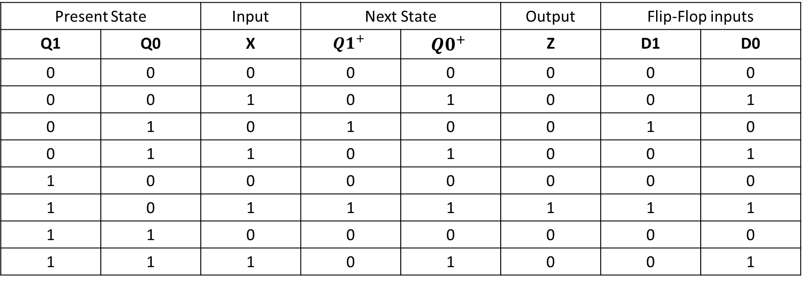


State Transition Table:
Present State |  | Input | Next State |  | Output | Flip-Flop inputs
Q1 | Q0 | X | $${Q1}^{+}$$ | $${Q0}^{+}$$ | Z | D1 | D0
0 | 0 | 0 | 0 | 0 | 0 | 0 | 0
0 | 0 | 1 | 0 | 1 | 0 | 0 | 1
0 | 1 | 0 | 1 | 0 | 0 | 1 | 0
0 | 1 | 1 | 0 | 1 | 0 | 0 | 1
1 | 0 | 0 | 0 | 0 | 0 | 0 | 0
1 | 0 | 1 | 1 | 1 | 1 | 1 | 1
1 | 1 | 0 | 0 | 0 | 0 | 0 | 0
1 | 1 | 1 | 0 | 1 | 0 | 0 | 1
D1
Q0 X
D0
Q0 X
Q1
00 01 11 10
Q1
00 01 11 10
0
1
0 | 0 | 0 | 1
0 | 1 | 0 | 0
0
1
0 | 1 | 1 | 0
0 | 1 | 1 | 0
$$Z=Q_{1}\overline{Q_{0}} X$$
$$D1=Q_{1}\overline{Q_{0}} X +\overline{Q_{1}}Q_{0}\overline{X}$$
$$D0= X$$

Slide 9












Circuit Implementation of Non Overlapping Sequence Detector:
X
D0
$$D1=Q_{1}\overline{Q_{0}} X +\overline{Q_{1}}Q_{0}\overline{X}$$
$$Q_{0}$$
$$D0=X$$
$$\overline{Q0}$$
$$\overline{Q_{0}}$$
$$Q1$$
X
$$Z=Q_{1}\overline{Q_{0}} X$$
X
D1
$$Q_{1}$$
$$\overline{X}$$
$$Q0$$
$$\overline{Q1}$$
$$\overline{Q_{1}}$$
clk

Slide 10
Step 10: Intuition and Teaching Notes
Think of the sequence detector as a “pattern lock”. Each state means “how much of the password you’ve entered correctly so far.”
Mealy is like a security system that checks the last key immediately (faster response).
Moore is like a system that only checks after confirming the whole password entry (slower, but simpler to reason about).
“No overlapping” is like a lock that resets completely once you’ve entered the code, so you cannot reuse digits.

Slide 11
Ques: Design a 3-bit sequence detector using D Flip-Flop to detect a sequence ‘101’ where overlapping is allowed. Show the State Diagram for Mealy and Moore Machine based implementation. Design the Moore Machine based implementation.

Slide 12
Problem — detect sequence 101 (overlap allowed)
Goal: Output 1 whenever the last three bits seen are 101. Because overlap is allowed, the final bit of a detected 101 can be the beginning of the next detection.
Example: input 10101 → detections at the 3rd and 5th bits (two outputs 1) because the trailing 1 of the first match can start the next match.
1) Intuition & state definitions
Think of the detector as a “memory of how much of the pattern you have matched so far”:
S0 — nothing matched (start).
S1 — last seen bit is 1 (we have matched prefix 1).
S2 — last two bits are 10 (we have matched prefix 10).
S3 — whole sequence 101 matched (for Moore machine this is the state with output = 1).
Because overlap is allowed, after seeing 101 the machine should move to the state that reflects the suffix of the matched sequence that can serve as a prefix for a new match. For 101, the suffix 1 is a valid prefix, so after S3 the next state depends on the next input but should allow continuation (e.g., on next input 1 we go to S1, on 0 to S2).
2) State transition rules (word description)
From each state, on input x:
S0 (no match yet)
  x=0 → stay S0
  x=1 → go S1
S1 (we have a 1)
  x=0 → go S2 (we have 10)
  x=1 → stay S1 (still just a trailing 1)
S2 (we have 10)
  x=0 → go S0 (sequence 100 is not prefix of 101)
  x=1 → go S3 (we just saw 101)
S3 (we are in the matched state) — Moore: output = 1 in this state
  x=0 → go S2 (because the last two bits become 10)
  x=1 → go S1 (because the last bit is 1)

Slide 13
3) State diagrams
(You can draw these easily from the text above; here’s how to label transitions.)
Mealy machine (brief)
Outputs on transitions. The output 1 occurs on the transition that consumes the 1 that completes 101. (I’ll focus on Moore implementation below, as you requested.)
Moore machine (outputs on states)
Four states S0, S1, S2, S3.
S3 is the only state with output 1.
Transitions are exactly as described in section (2)
4) Moore state table (present state → next state & output)
Use x as the serial input. Output Z depends only on the present state for Moore.
(We assigned binary encodings: S0 = 00, S1 = 01, S2 = 10, S3 = 11.)
Present State | (Q1 Q0) | Output Z | x=0 → Next State (Q1' Q0') | x=1 → Next State (Q1' Q0')
S0 | 00 | 0 | S0 → 00 | S1 → 01
S1 | 01 | 0 | S2 → 10 | S1 → 01
S2 | 10 | 0 | S0 → 00 | S3 → 11
S3 | 11 | 1 | S2 → 10 | S1 → 01

Slide 14




State Transition Diagram
0
$$\frac{S0}{0}$$
0/0
S0
1
$$\frac{S1}{0}$$
1
1/0
0/0
0
S1
1/0
0
0/0
$$\frac{S2}{0}$$
1
1/1
S2
1
0
$$\frac{S3}{1}$$
Mealy Machine based implemented State diagram
Moore Machine based implemented State diagram

Slide 15
In the above diagram,
S0: represents an initial state where none of the bits of interest have arrived
S1: when ‘1’ has arrived
S2: when ‘10’ has arrived
S3: when ‘101’ has arrived
Note that Moore Machine has more states than Mealy Machine. But the advantage with Moore Machine is it gives output as ‘1’ only when ‘101’ have arrived and clock pulse is arrived.
However, in Mealy Machine output becomes ‘1’ as soon as input becomes ‘1’ while the circuit is in S2 state even before clock pulse arrived.
So for 4 states, 2 flip flops are required. Call their output as Q1, Q0.

Slide 16

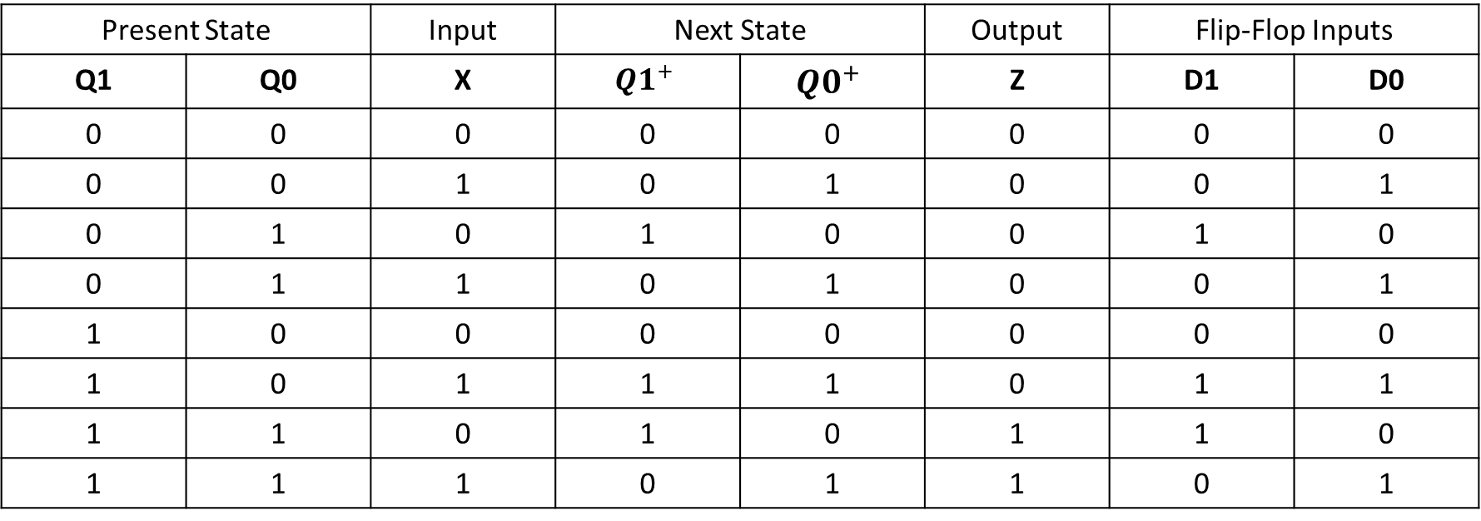


State Transition Table:
Present State |  | Input | Next State |  | Output | Flip-Flop Inputs
Q1 | Q0 | X | $${Q1}^{+}$$ | $${Q0}^{+}$$ | Z | D1 | D0
0 | 0 | 0 | 0 | 0 | 0 | 0 | 0
0 | 0 | 1 | 0 | 1 | 0 | 0 | 1
0 | 1 | 0 | 1 | 0 | 0 | 1 | 0
0 | 1 | 1 | 0 | 1 | 0 | 0 | 1
1 | 0 | 0 | 0 | 0 | 0 | 0 | 0
1 | 0 | 1 | 1 | 1 | 0 | 1 | 1
1 | 1 | 0 | 1 | 0 | 1 | 1 | 0
1 | 1 | 1 | 0 | 1 | 1 | 0 | 1
D1
Q0 X
D0
Q0 X
00 01 11 10
Q1
00 01 11 10
Q1
0
1
0 | 0 | 0 | 1
0 | 1 | 0 | 1
0
1
0 | 1 | 1 | 0
0 | 1 | 1 | 0
$$Z=Q_{1} Q_{0}$$
$$D1=Q_{1}\overline{Q_{0}} X + Q_{0}\overline{X}$$
$$D=X$$

Slide 17





Circuit Implementation of Overlapping Sequence Detector:
X
D0
$$D1=Q_{1}\overline{Q_{0}} X +\overline{Q_{1}}Q_{0}X$$
$$Q_{0}$$
$$D0= X$$
$$\overline{Q_{0}}$$
$$\overline{Q0}$$
$$Z=Q_{1} Q_{0}$$
Q1
X
D1
$$Q_{1}$$
Q0
$$\overline{X}$$
$$\overline{Q_{1}}$$
clk

Slide 18
Ques: Design a 3-bit Gray Code Counter.
Sequence:
000→ 001→011→ 010 → 110→ 111→101→ 100 →000

Slide 19
1 — Understand the target sequence (intuition)
This counter cycles through the 8 three-bit Gray code values in the order you listed.
Key property of Gray code: only one bit changes on each step. That makes it good where glitching due to multiple simultaneous bit changes should be avoided (e.g., analog mux addresses, rotary encoders). Here we design a synchronous 3-bit counter using three D flip-flops (Q2 Q1 Q0) which advances on each clock to the next Gray code in the sequence.
We will implement the counter as a synchronous finite state machine: present state = current 3-bit output, next state = next code in sequence. For Moore/Mealy distinction there’s no extra output besides the state; we implement the next-state logic directly into D inputs of the D-FFs.

Slide 20
2 — Assign present → next mapping (state table)
List every present code and the next code (from your sequence):
Present (Q2 Q1 Q0) | Next (Q2⁺ Q1⁺ Q0⁺)
000 | 001
001 | 011
011 | 010
010 | 110
110 | 111
111 | 101
101 | 100
100 | 000

Slide 21

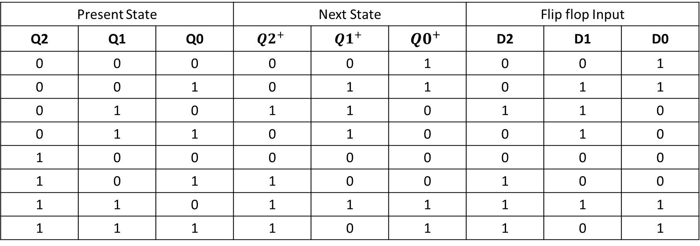


Present State |  |  | Next State |  |  | Flip flop Input
Q2 | Q1 | Q0 | $${Q2}^{+}$$ | $${Q1}^{+}$$ | $${Q0}^{+}$$ | D2 | D1 | D0
0 | 0 | 0 | 0 | 0 | 1 | 0 | 0 | 1
0 | 0 | 1 | 0 | 1 | 1 | 0 | 1 | 1
0 | 1 | 0 | 1 | 1 | 0 | 1 | 1 | 0
0 | 1 | 1 | 0 | 1 | 0 | 0 | 1 | 0
1 | 0 | 0 | 0 | 0 | 0 | 0 | 0 | 0
1 | 0 | 1 | 1 | 0 | 0 | 1 | 0 | 0
1 | 1 | 0 | 1 | 1 | 1 | 1 | 1 | 1
1 | 1 | 1 | 1 | 0 | 1 | 1 | 0 | 1
D2
Q1 Q0
D1
Q1 Q0
D0
Q1 Q0
Q2
00 01 11 10
Q2
00 01 11 10
Q2
00 01 11 10
0
1
0 | 0 | 0 | 1
0 | 1 | 1 | 1
0
1
0 | 1 | 1 | 1
0 | 0 | 0 | 1
0
1
1 | 1 | 0 | 0
0 | 0 | 1 | 1
$$D2=Q_{1}\overline{Q_{0}}+Q_{2}Q_{0}$$
$$D1=Q_{1}\overline{Q_{0}}+\overline{Q_{2}}Q_{0}$$
$$D0= \overline{Q_{2}} \overline{Q_{1}}+Q_{2}Q_{1}$$

Slide 22







D2
$$Q_{2}$$
$$\overline{Q_{2}}$$
D1
$$Q_{1}$$
$$\overline{Q_{1}}$$
D0
$$Q_{0}$$
$$CLK$$
$$\overline{Q_{0}}$$

